Slide 1
Beer Ratings Analysis & Prediction
MSDS 6306 Case study 2
Bhuvana Adur Kannan
Christopher Ballenger
Selwyn Samuel

Slide 2
Outline
Project Goals
Data Gathering
Feature Selection
Modeling
Results

Slide 3
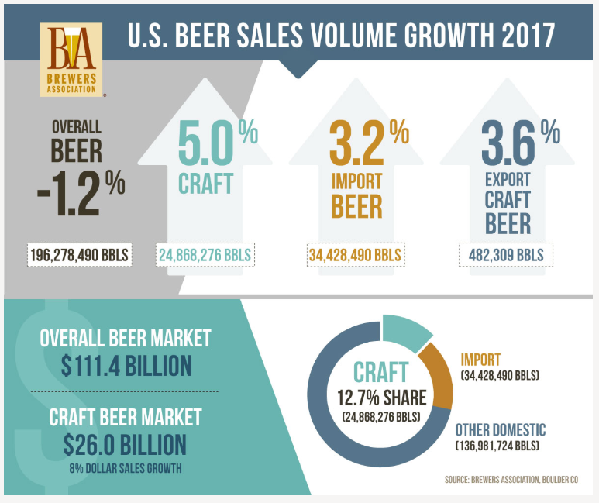
Beer Industry
Trend
Overall beer sales down 1%
Craft & Import beer sales up 8%
23% of overall beer sales
Beer drinkers are turning into beer enthusiasts & beer connoisseurs
“For me, it equates to a sense of adventure – collecting sensory experiences through flavor profiles like Indiana Jones collects priceless artifacts. The excitement of a satisfying brew, falling into off-flavors – these experiences belong in the museum of your mind!”
- Katy Tilley (DESTIHL Brewery Ambassador)
Source: https://www.brewersassociation.org

Slide 4
Questions
Is there a bias in the way beer enthusiasts rate a beer at a brewery location and other locations?
Can we predict an introductory market or area where a beer will be successful?
When a beer enthusiast/connoisseur walks into a brewery can we recommend a beer that he/she would like based on their past ratings profile?

Slide 5
Project Goals
Data Science Project Life Cycle
Reproducible research
Apply Statistics lessons from MSDS 6371
Problem analysis & Identification of tests
Learn new technologies
APIs, Web Scraping, ML algorithms, H₂O Platform
Learn the model and not Perfect the model
Run evaluations on the model
Report statistics on the model

Slide 6
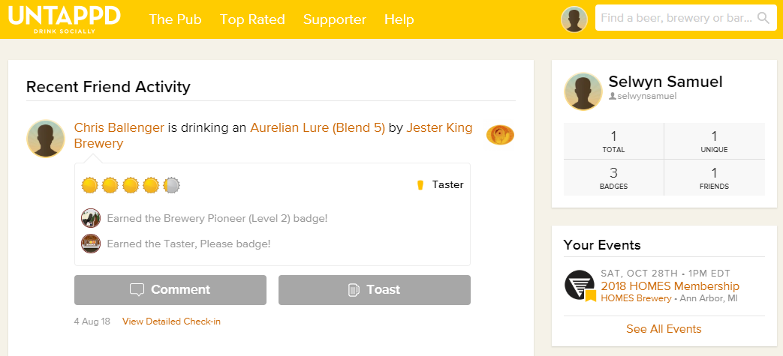


Data Gathering
R Code to get JSON Objects
5 Users, 300+ check-ins, 1500 observations
1100 beer details
rvest & Rselenium packages, CSS Selector
Tricky “show more” logic
HTML parse -> data frame -> CSV files
API
Web Scraping
Long API Client approval process
100 Calls per hour restriction
IP Black-listed – Intelligent Proxies
Throttle http calls

Slide 7
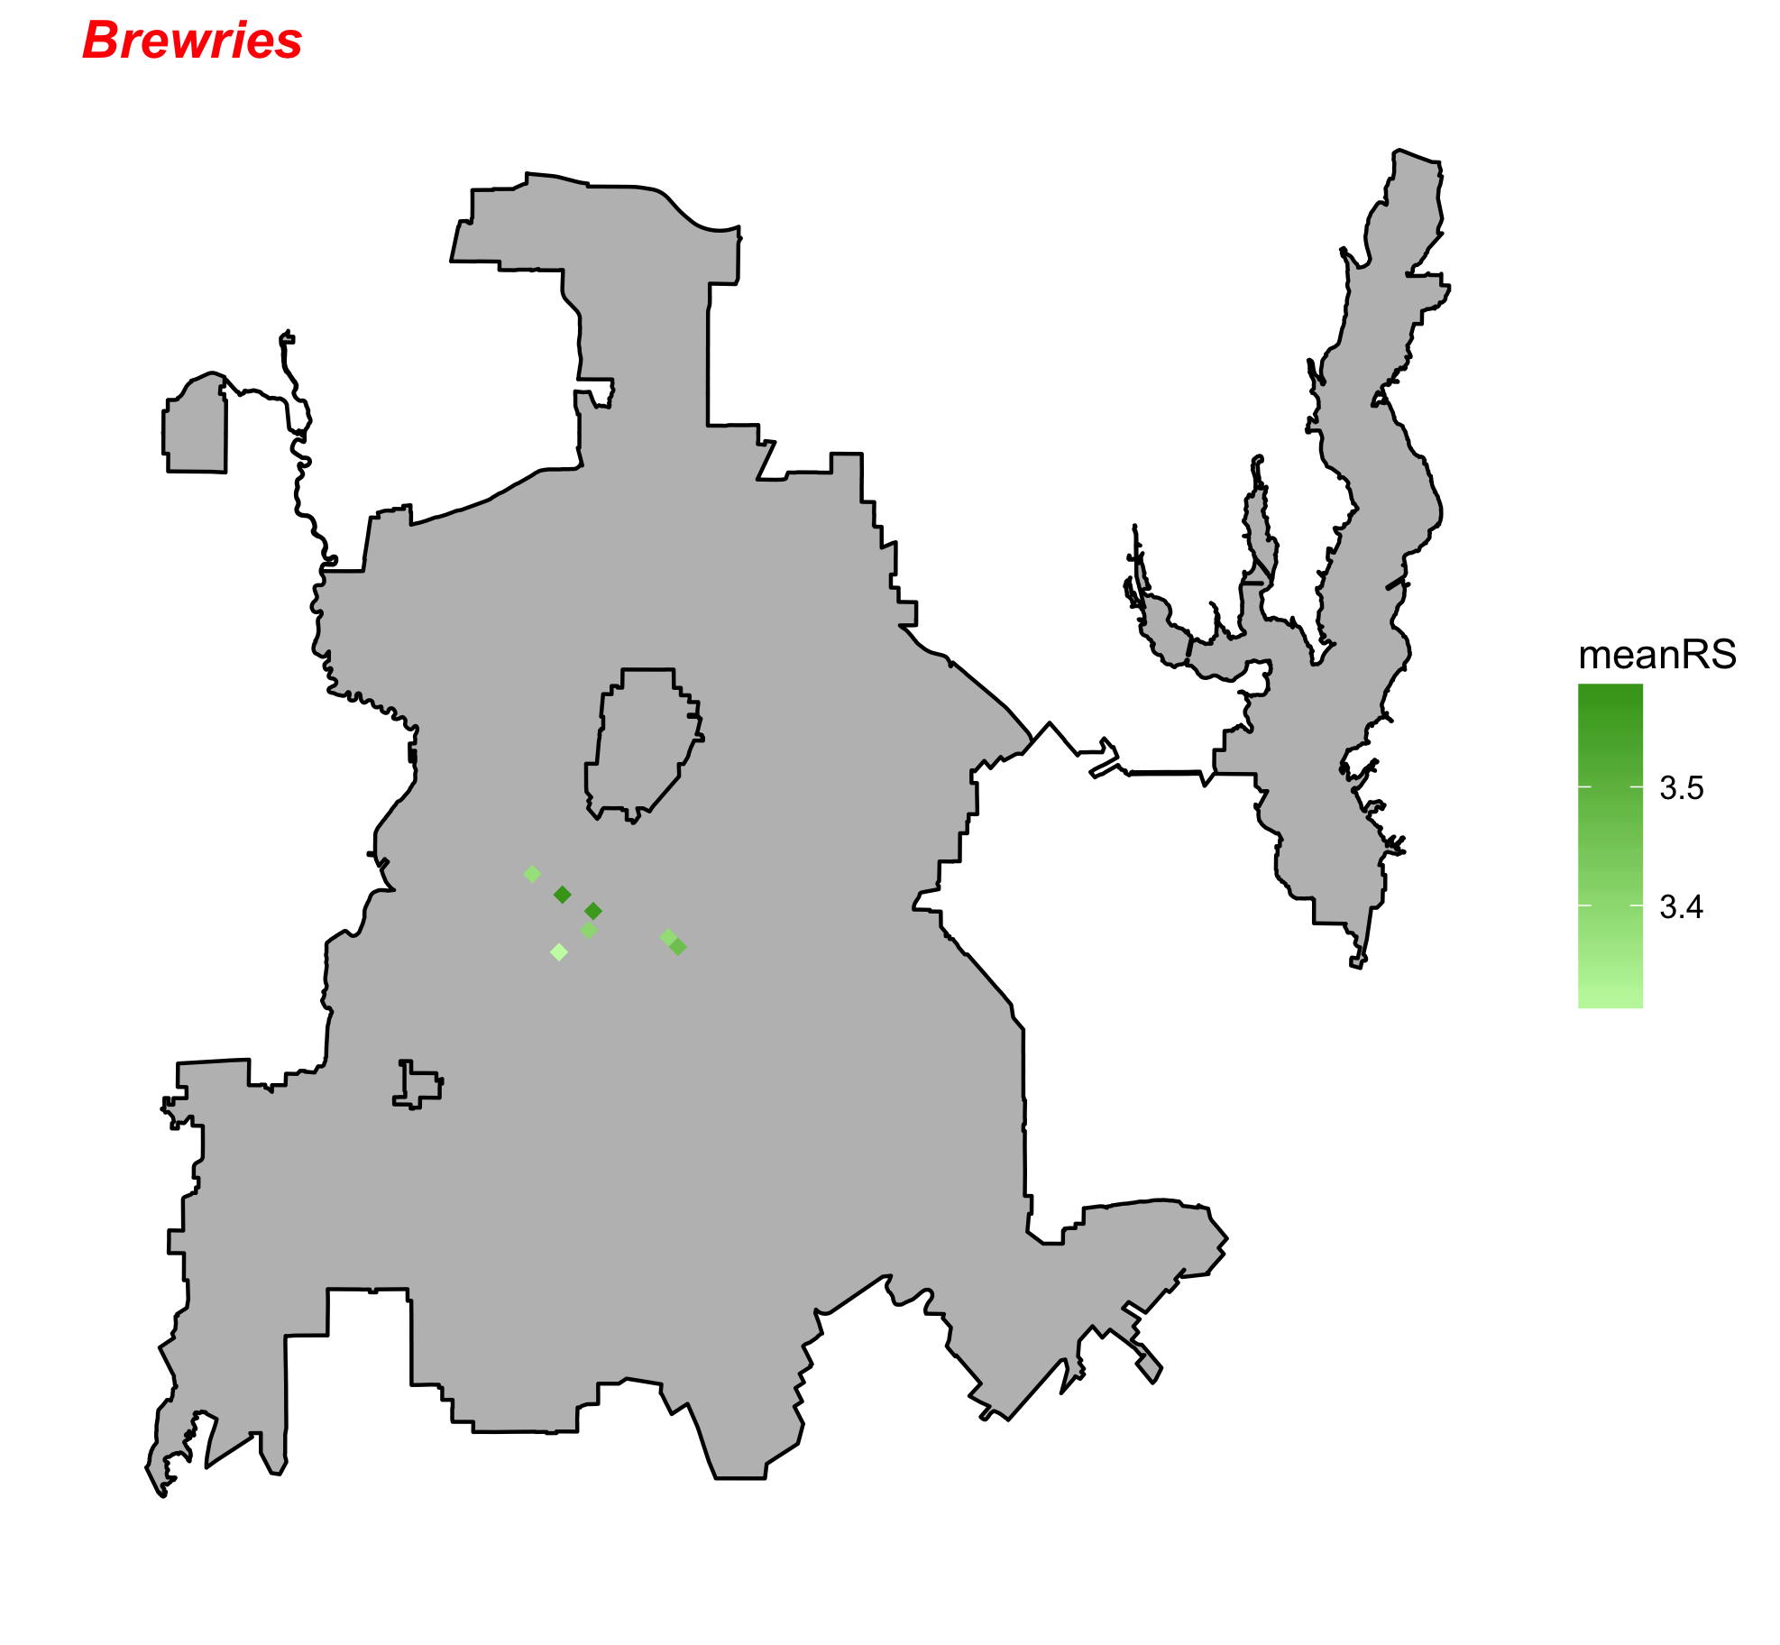
Breweries we targeted
Community Beer Company
Four Corners Brewing Company
Deep Ellum Brewing Company
BrainDead Brewing
Noble Rey Brewing Company
Texas Ale Project
Peticolas Brewing Company

Slide 8
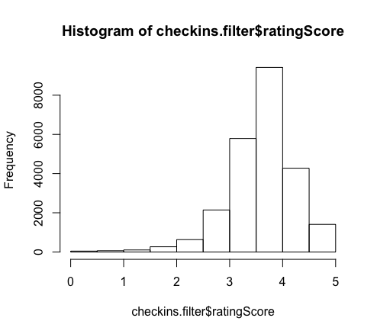
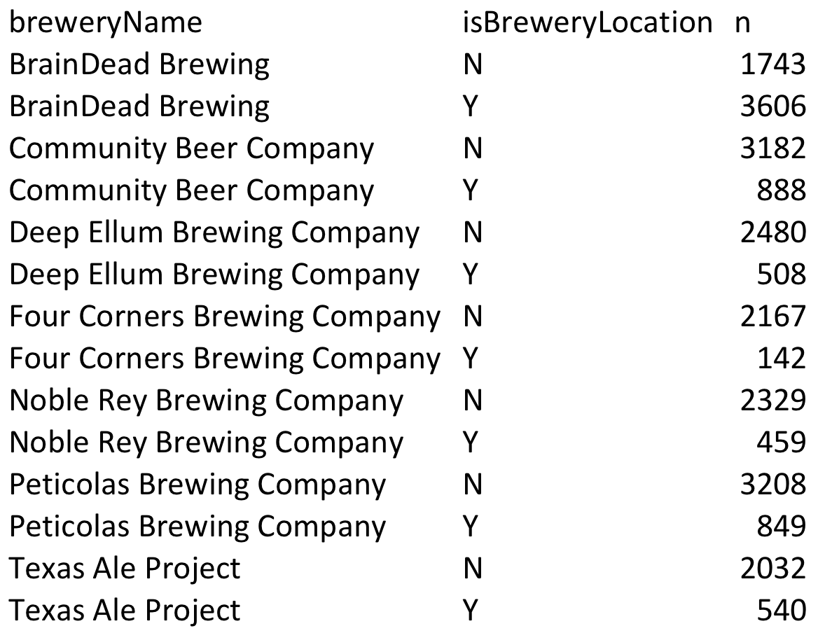
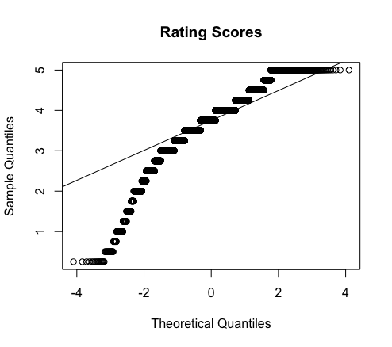
Bias in how we rate beers - Assumptions
The data appears to have a right skewness, however given its large sample size CLT will be robust from violations.
User can check in the same beer multiple time in multiple locations, in order to account for independenct we will average the users rating based on location; at brewery / not at brewery.

Slide 9
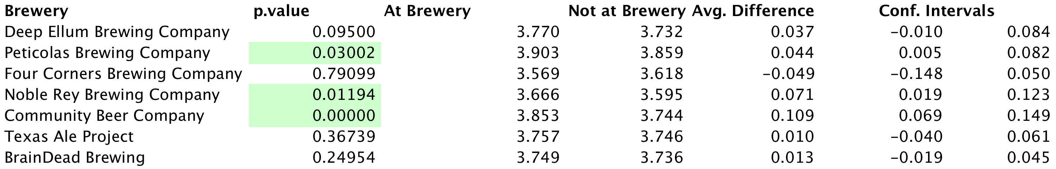
Conclusion
At a significant level of .05, Peticolas, Nobel Rey, and Community mean rating is greater while consumed at the brewery versus not at the brewery. A 95% confident intervals are listed above.
The average differences are small and we will need to research additional confounding variables to be imply any real changes; such as beer styles and person preferences.
This was an observational study thus no casual inferrence can be made from the study. The data was consumed from one week worth of 300 check-ins per beer and not a random sample. We can only generalize from this population.
Full test can be found on our github repository: LocationBias.Rmd

Slide 10
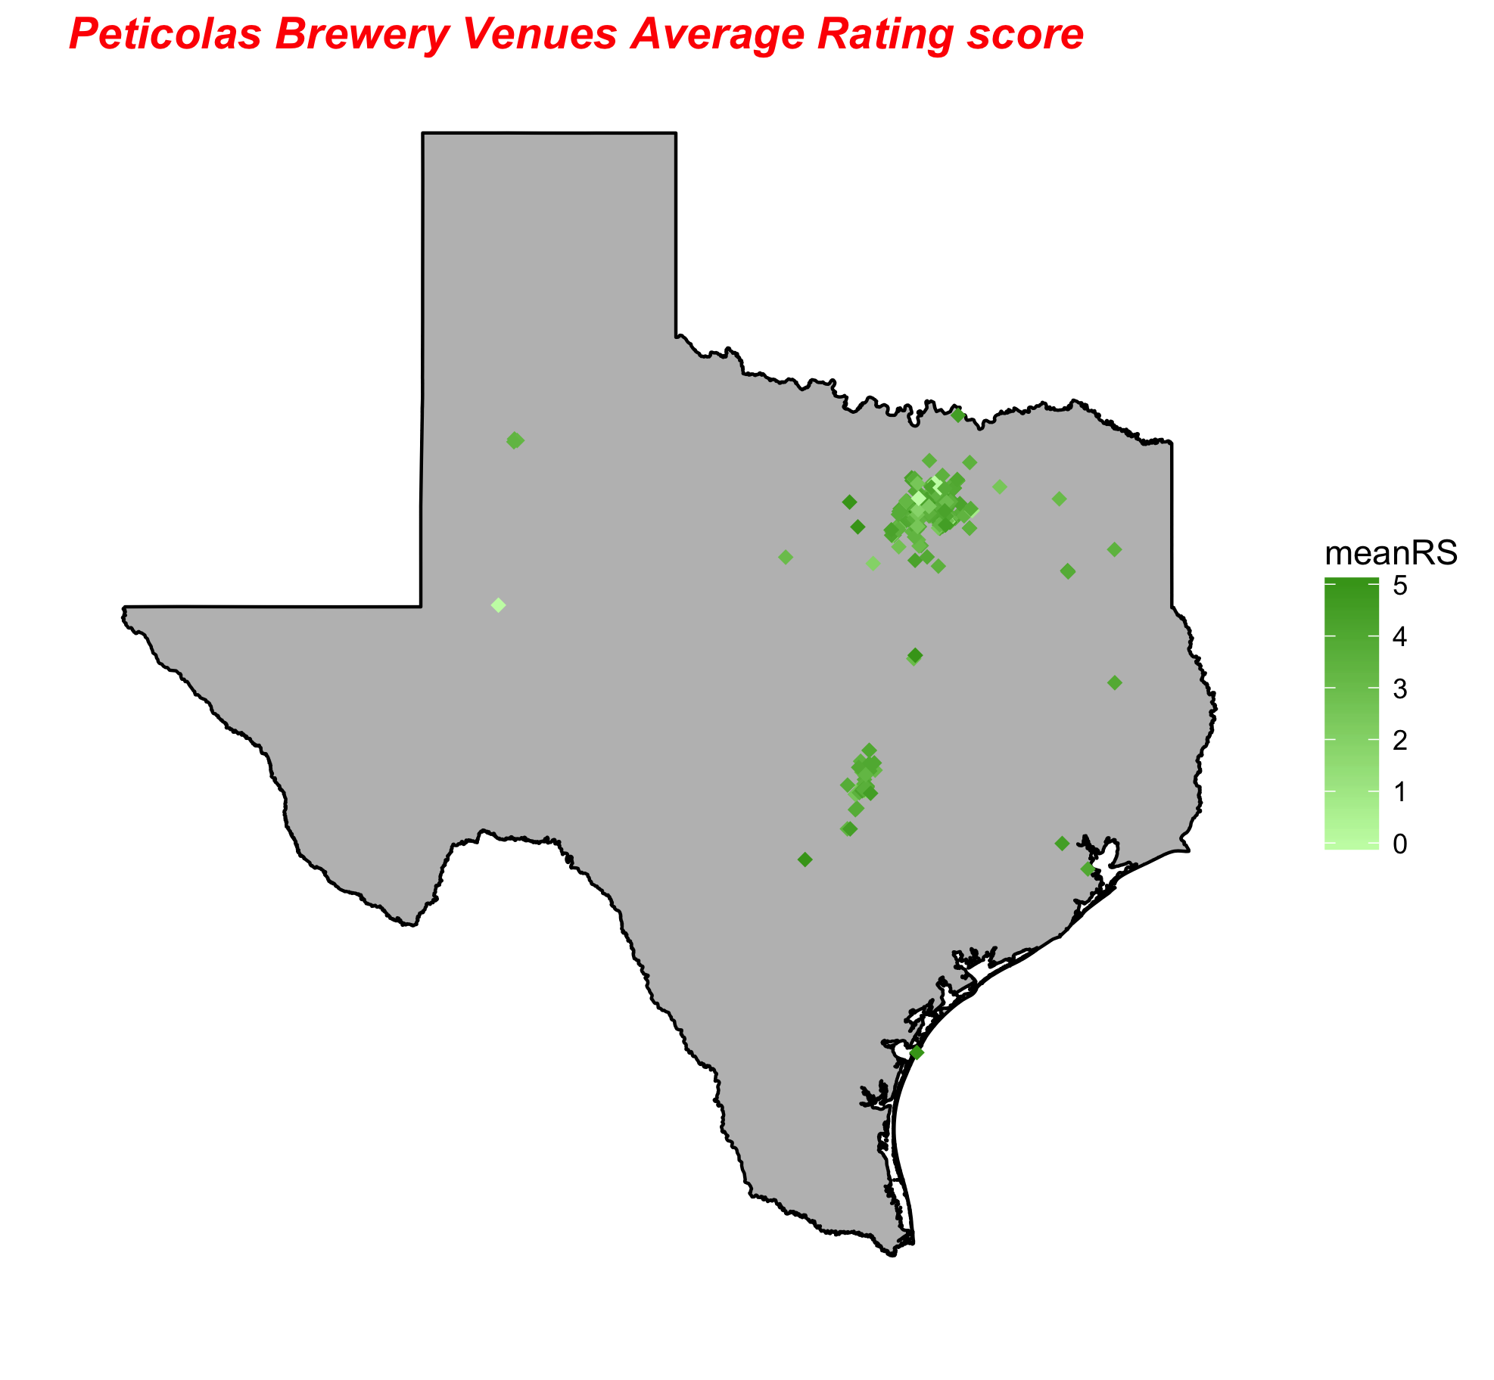
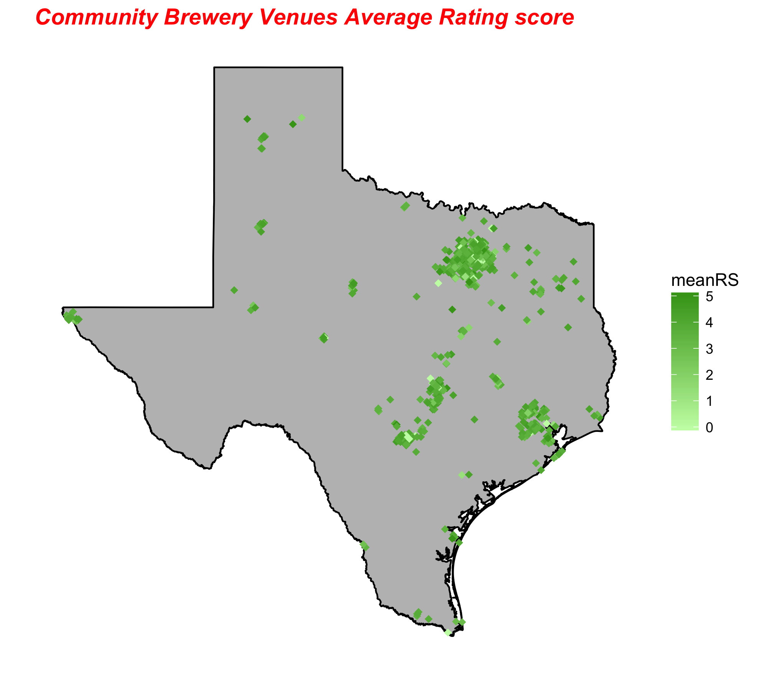
Where are people checking in beers?

